Slide 1
Analysis of KEKE English
Team 2：胡碧皓 武美玖 韩庆慧 刘冠群 潘香霖

Slide 2
Introduction
Environment and Object
Behavior and Interaction
CONTENTS
Experience and Interact Object

Slide 3
01
Introduction

Slide 4
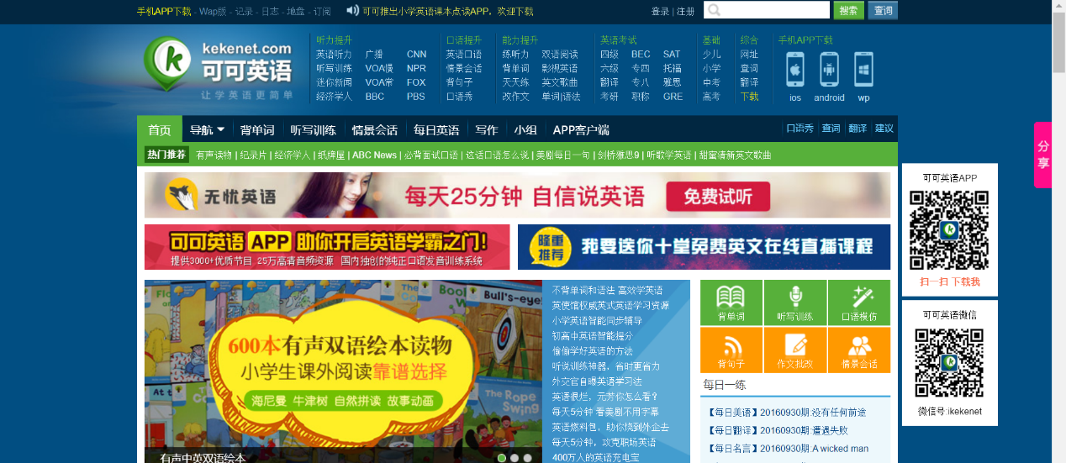
Introduction

Slide 5

Introduction
Rich selection of learning resources
Supporting the operation such as offline learning, reciting words, listening, speaking and reading training
Regularly reminded and learning record synchronization of cloud
Clocking in sharing(打卡)
KEKE beans to exchange gifts

Slide 6
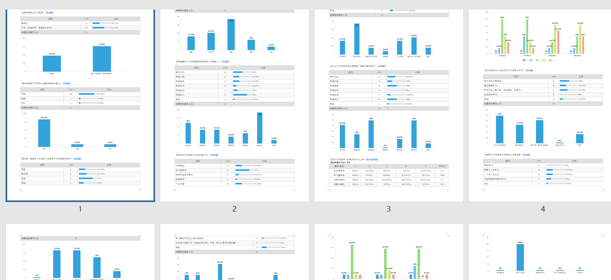
Questionnaire

Slide 7
02
Environment and Object

Slide 8
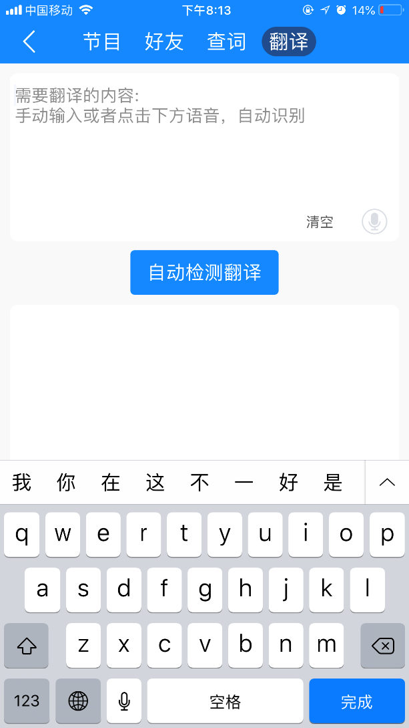
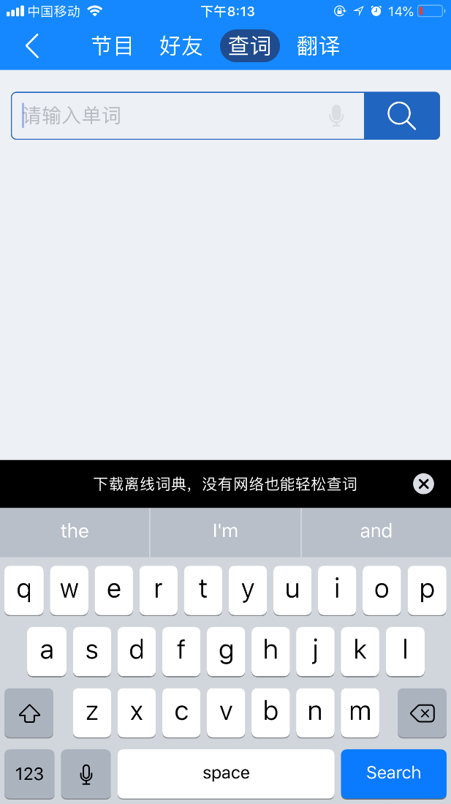
Environment-Where to learn
Space flexible
APP or PC, and the two can keep data synchronization.
Time freedom
No regular time.
Words or sentences translate in time.

Slide 9
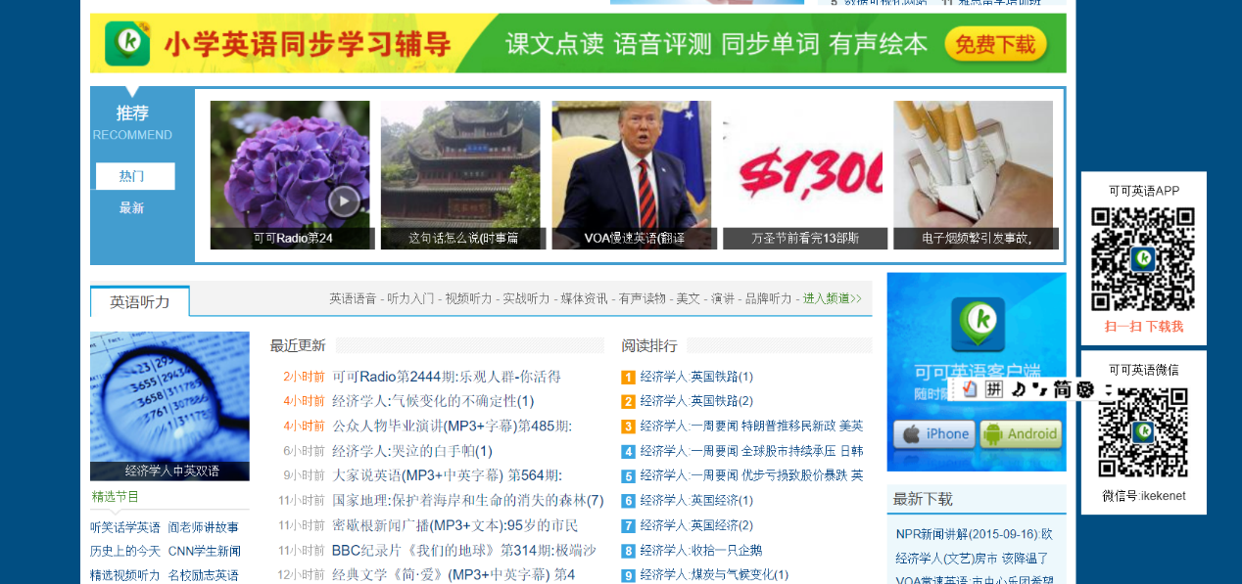
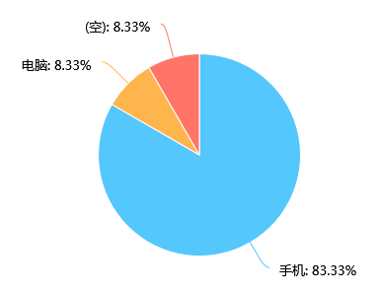
Environment-Where to learn
Suggestion：Simplify official website

Slide 10
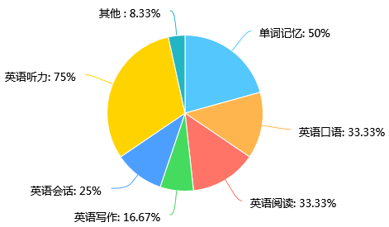
Knowledge, Skills, Attitude-What to learn
Support language knowledge learning
Various pronunciation exercises
Rich in vocabulary
All-round grammar
Strengthen language skills training
Enhance interests in English learning

Slide 11
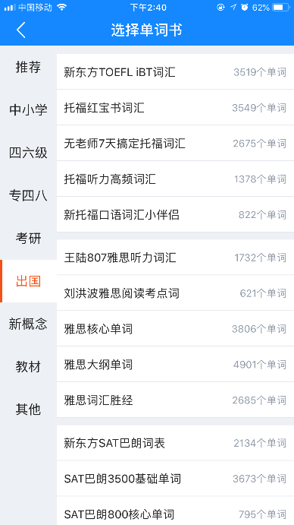
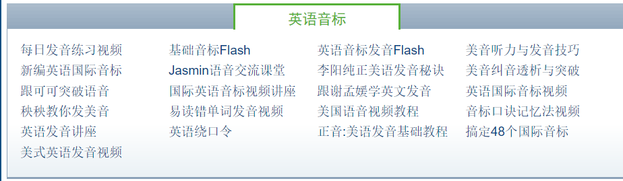
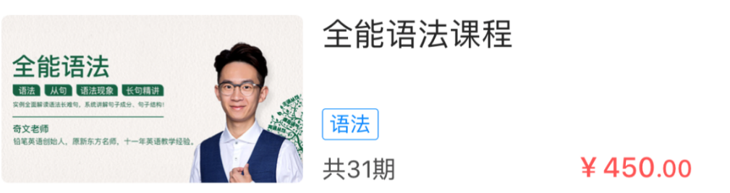
Knowledge, Skills, Attitude-What to learn
Knowledge

Slide 12
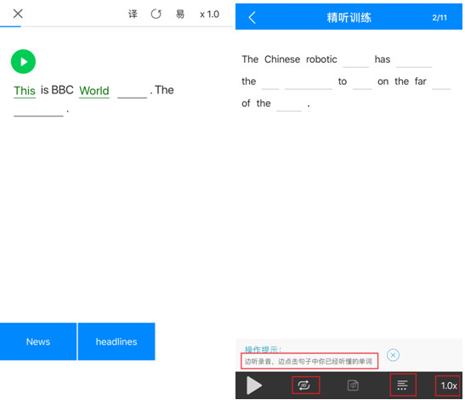
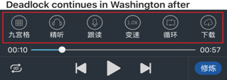
Knowledge, Skills, Attitude-What to learn
Skills

Slide 13
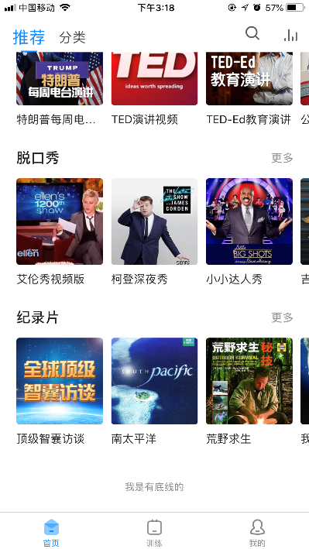
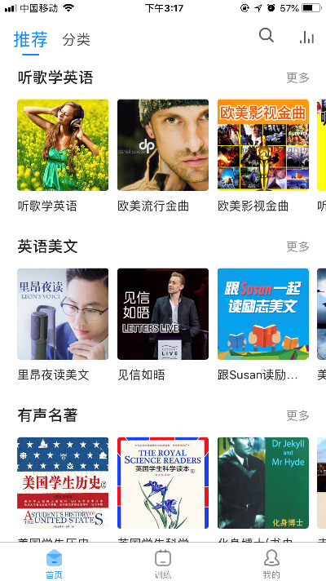
Knowledge, Skills, Attitude-What to learn
Attitude

Slide 14
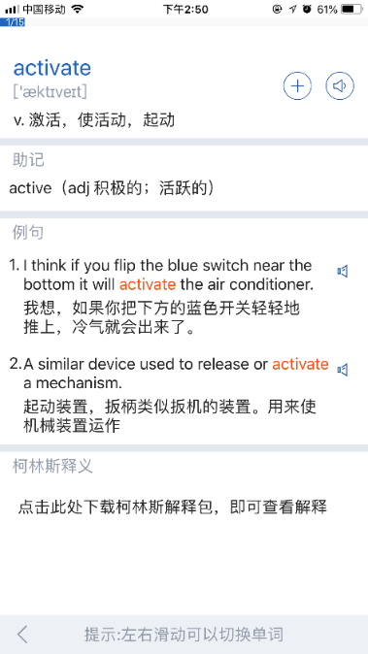
Knowledge, Skills, Attitude-What to learn
Suggestions:
Set“know”or“don’t know”function when recitation.
Add “English explanations”, “picture association”, “synonyms” function.
Allow two or more types of word books to be studied at the same time.
Add English pronunciation practice module on the mobile phone.

Slide 15
03
Behavior and Interaction

Slide 16
Behavior-Effect of learning
a) Motivation
Everyone can find their interests in abundant and integrated contents.
b) Engagement
Sign in and learn everyday to earn some more KEKE beans.
Ranking list.
c) Learning achievement
Results would be reflected in-time and unlock more learning contents.
Examination function.

Slide 17
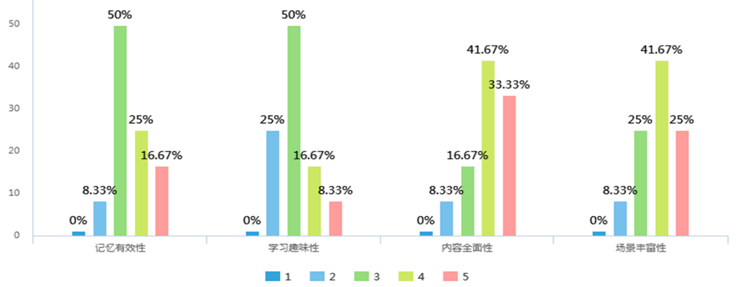
Behavior-Effect of learning
Suggestion:
Broaden examination field.
Exam comprehensive ability.

Slide 18
Interaction-How to learn
Manner
KEKE teacher App.
The function of speech recognition.

Slide 19
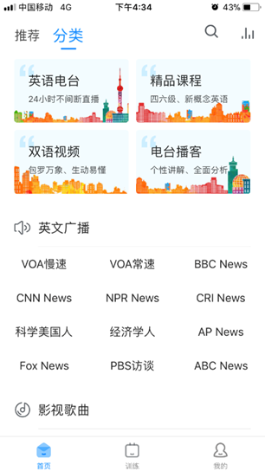
Interaction-How to learn
Media
Various of interactive media.
English video, radio, broadcasting station, real time news, TV music, simulated examination etc.

Slide 20
04
Experience and Interact Object

Slide 21
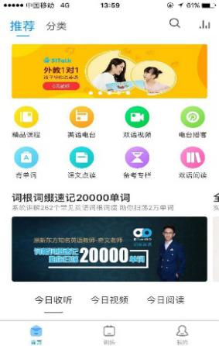
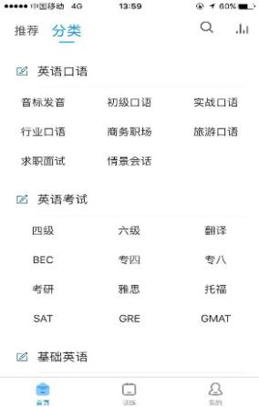
Experience-The process
Accessibility
Lots of materials about videos, articles, words bank.
Free content.
Earn “KEKE beans” to exchange materials.

Slide 22
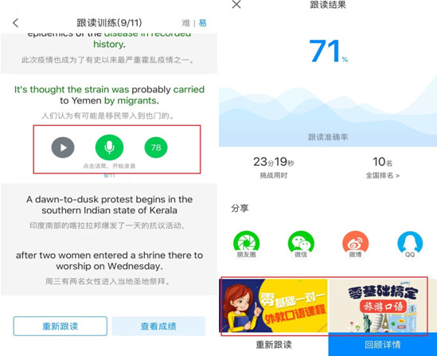
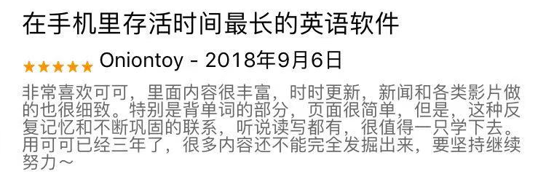
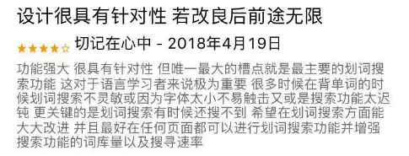
Experience-The process
Availability
An Intelligent English scoring system.

Slide 23
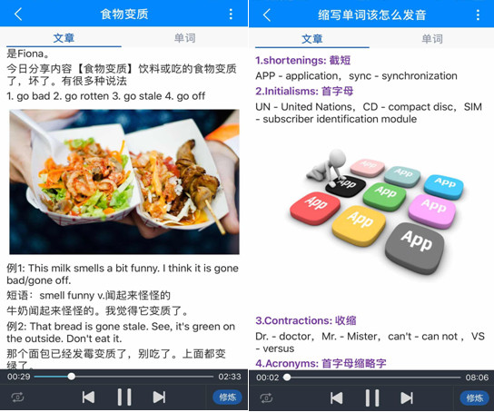
Experience-The process
Happiness
Set a lot of interesting learning materials.
Radio blogs, bilingual video, movies and songs.

Slide 24
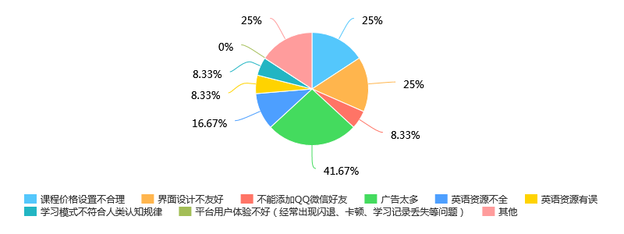
Experience-The process
Suggestions:
Strengthen the part that users can set
Ensure a stable environment
optimize interface design
feedback method

Slide 25
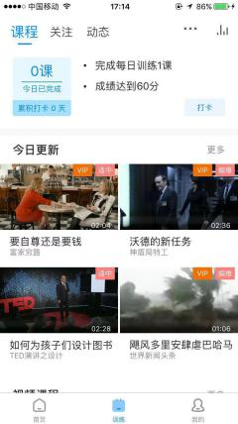
Interact Object-From who to learn
Human-machine interaction
Choose the degree of difficulty and recommend learning resources suitable for learners.
More unilateral output of knowledge.
Human-human interaction
Teachers and students interaction :
The function of class.
Students and students interaction :
Discussion group.
Dynamic and “Like" function.

Slide 26
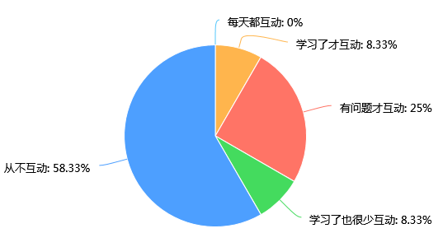
Interact Object-From who to learn
Suggestions:
Add the function of comment.
Increase interactive encouragement mechanism.

Slide 27
Thank you for listening
2019.9.27

